Slide 1


Active Inference and the Free Energy Principle Bert de Vries Eindhoven University of Technology Nov 2025

Slide 2

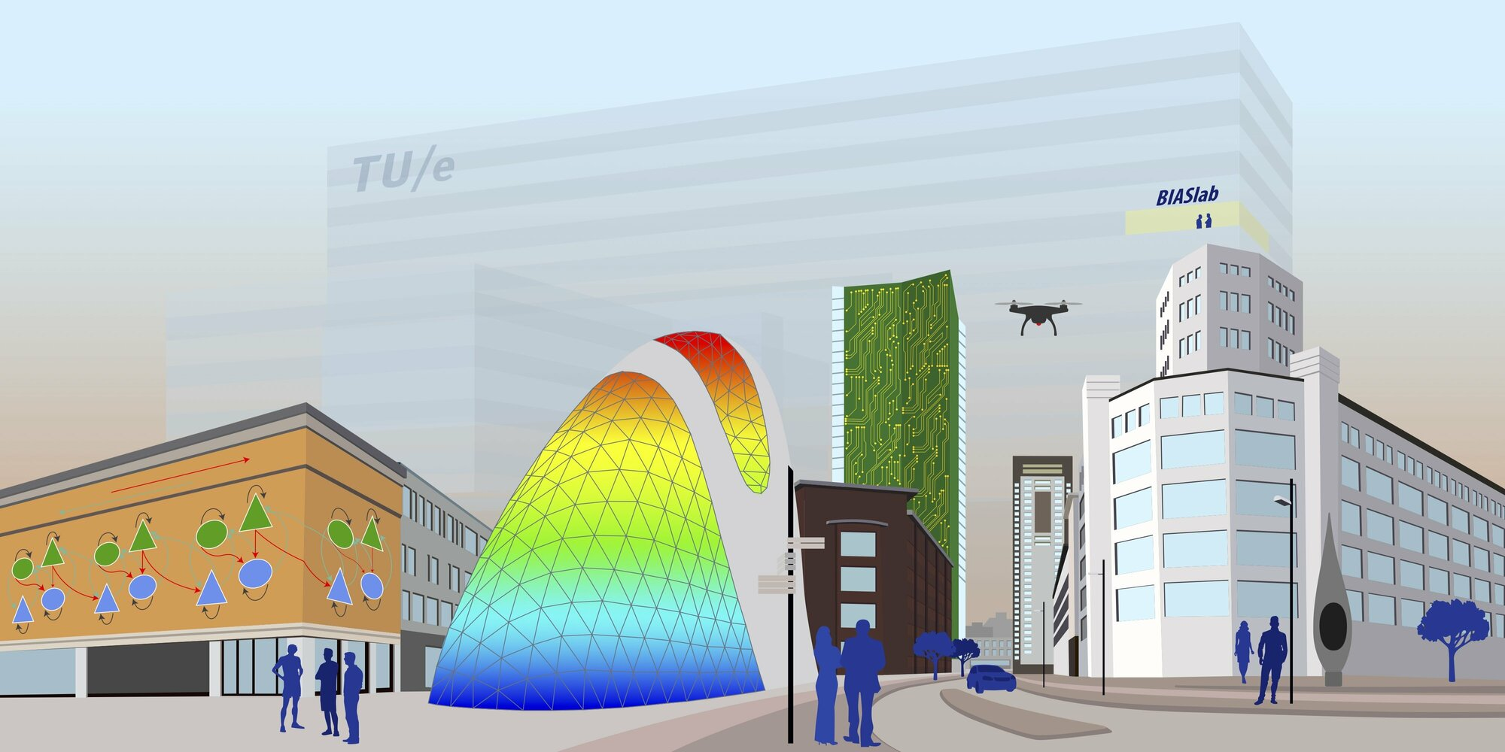




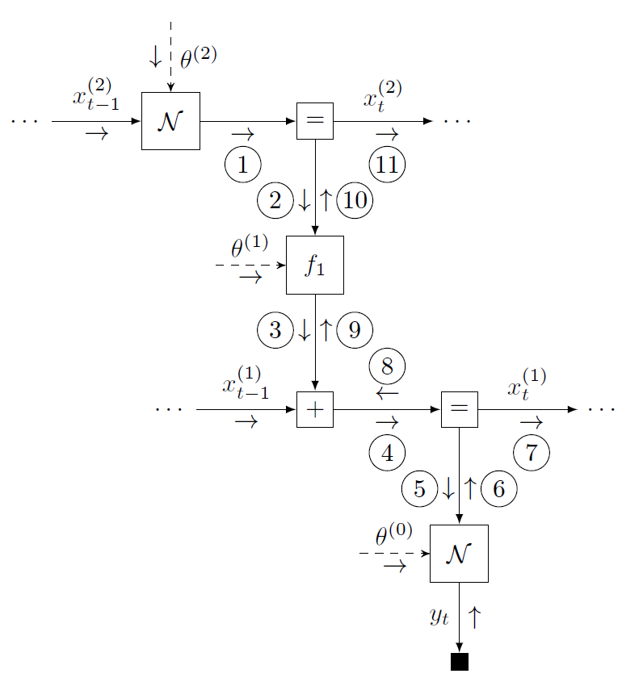

BIASlab
2023 - present
2014 - present
Acknowledgments
Sepideh Adamiat, Semih Akbayrak, Dmitry Bagaev, Marco Cox, Bart van Erp, Marco Hidalgo, Tanya Ignatenko, Thijs Jenneskens, Chanfeng Jia, Magnus Koudahl, Wouter Kouw, Joris Kraak, Thijs van de Laar, Alex Ledbetter, Mykola Lukashchuk, Hoang Nguyen, Ivana Nikoloska, Tim Nisslbeck, Wouter Nuijten, Albert Podusenko, Ismail Senoz, Raaja Subramanian, Raphael Tresor, Martin Roa Villescas, and many others

Slide 3


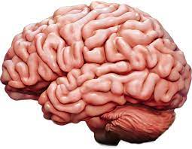
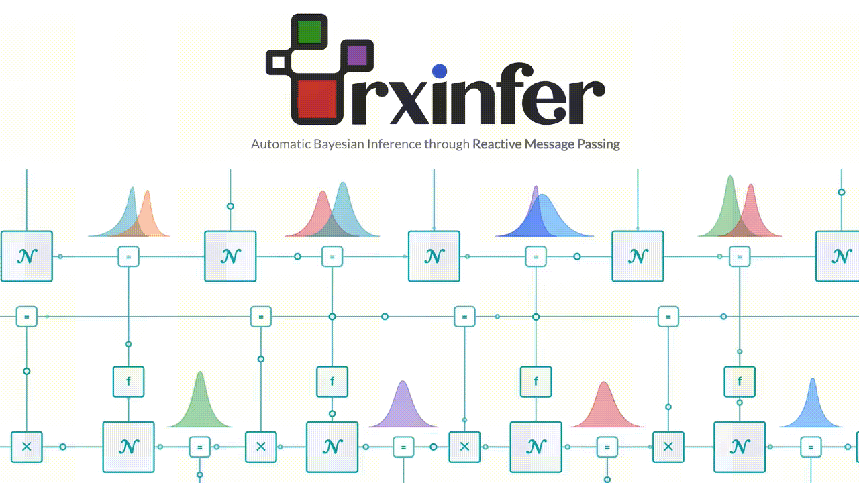
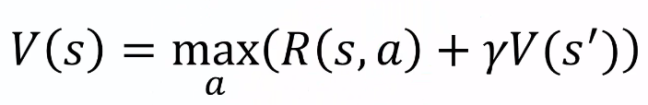
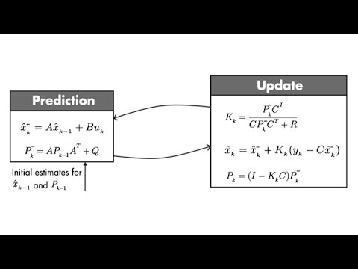
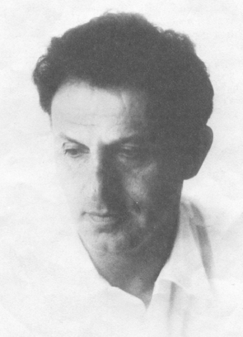
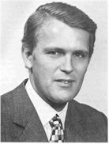
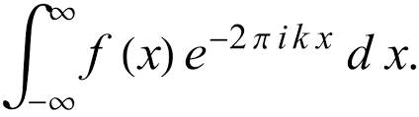
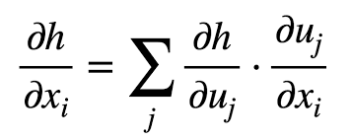
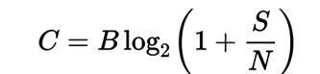
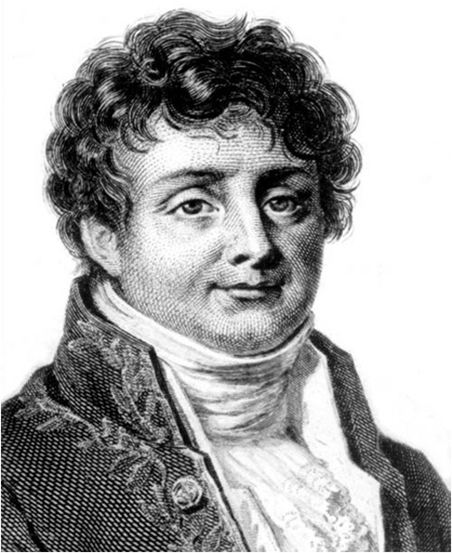
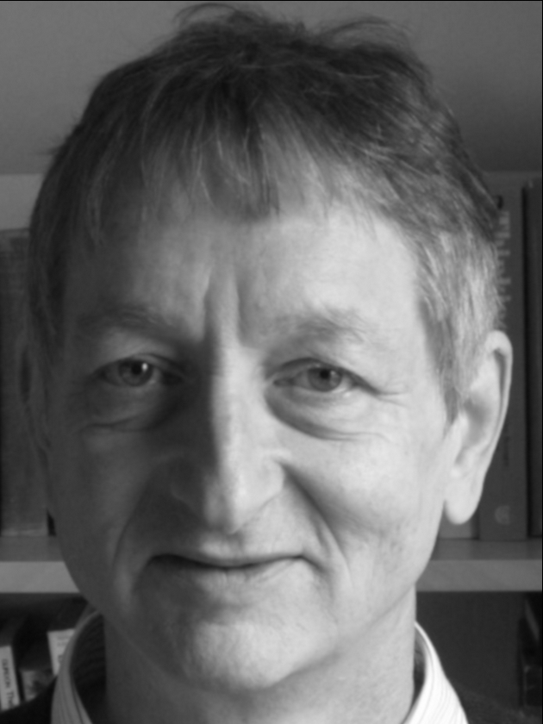
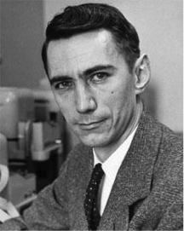
Motivation
Physics
Simulated
Physics
?
Robotics
Control Theory
Signal Processing
Machine Learning
Communication
Richard Bellman
Rudolf Kalman
Joseph Fourier
Geoffrey Hinton
Claude Shannon

Slide 4
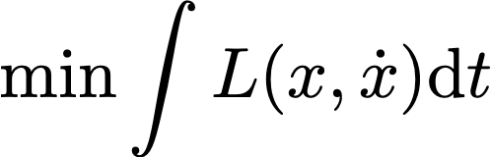
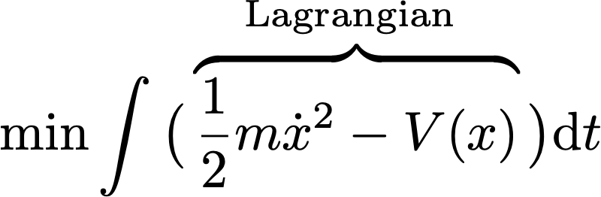
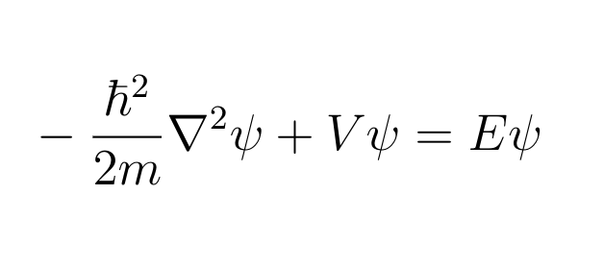
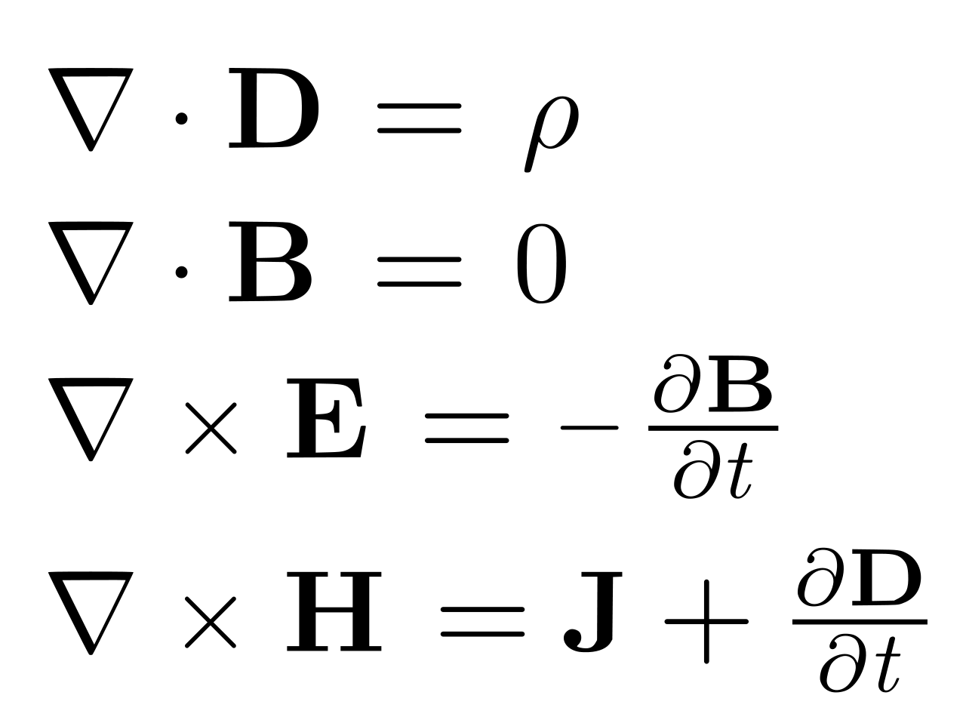
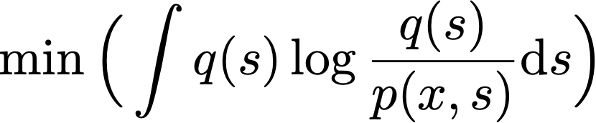
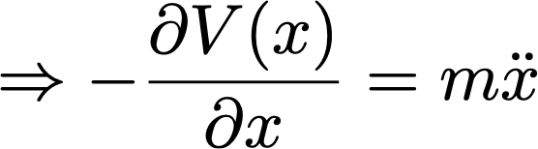
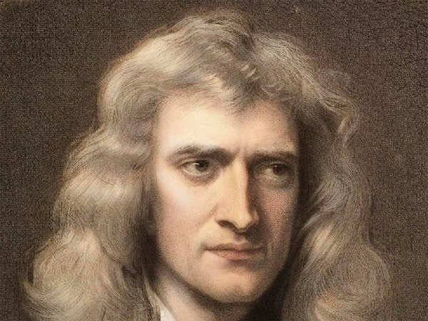
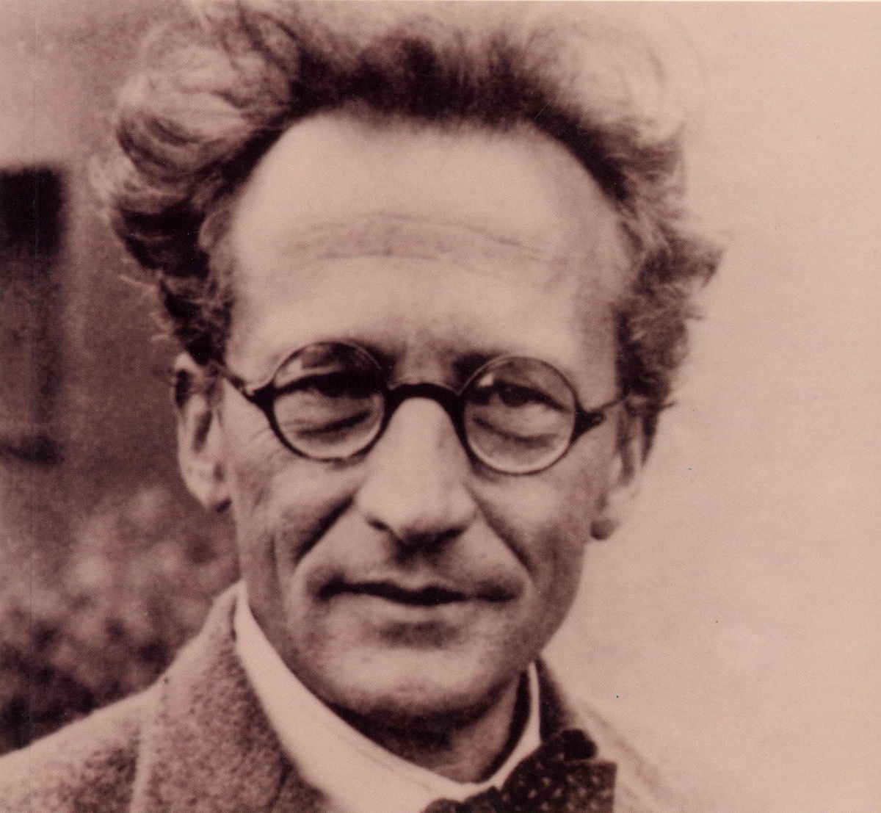
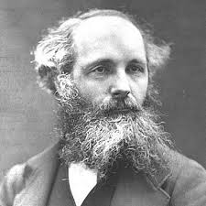
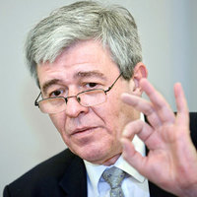
The Principle of Least Action
“In nature, energy differences of any kind are neutralized as fast a possible”
$$t_{0}$$
$$t_{1}$$
$$m$$
Free Energy Principle
Movement of
big things
(classical mechanics)
Movement of
small things
(quantum mechanics)
Movement of
electromagnetic fields
(electrodynamics)
Movement of
beliefs in brains
(Bayesian mechanics)
Isaac Newton
Erwin Schrodinger
James C. Maxwell
Karl Friston
Notes:
Maxwell:” L.D. Landau & E.M. Lifshitz, The Classical Theory of Fields, Vol. 2 of Course of Theoretical Physics
➤ Chapter 1–3 give an elegant derivation using field Lagrangians.
L.D. Landau & E.M. Lifshitz, Quantum Mechanics: Non-Relativistic Theory, Vol. 3
➤ Rigorous derivation of Schrödinger equation from variational principles.
Parr & Friston (2019), Generalised Free Energy and Active Inference:
“The accuracy term… acts like a potential energy in that it pulls beliefs towards states that are compatible with sensory data.” (DOI:10.1007/s00422-019-00805-w)

Slide 5
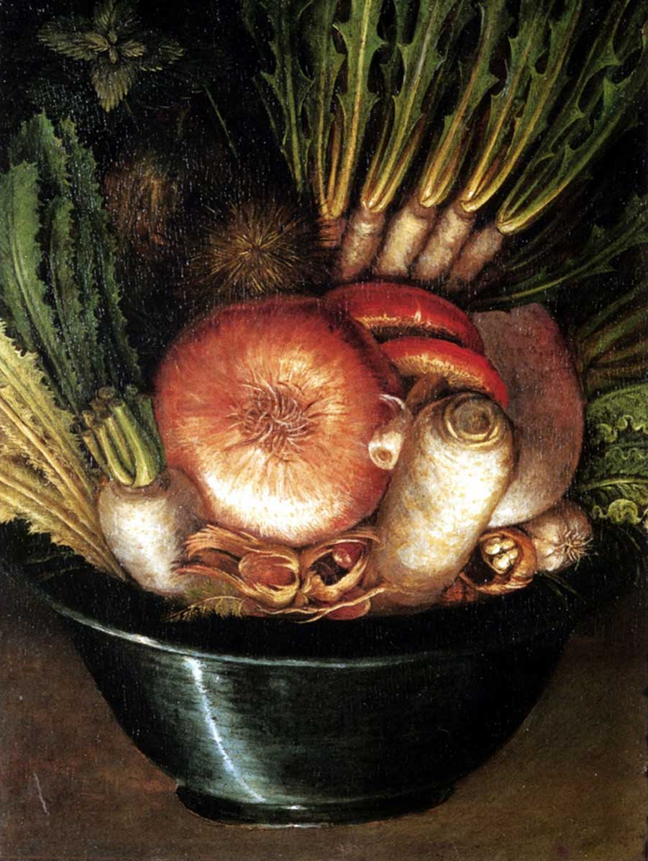
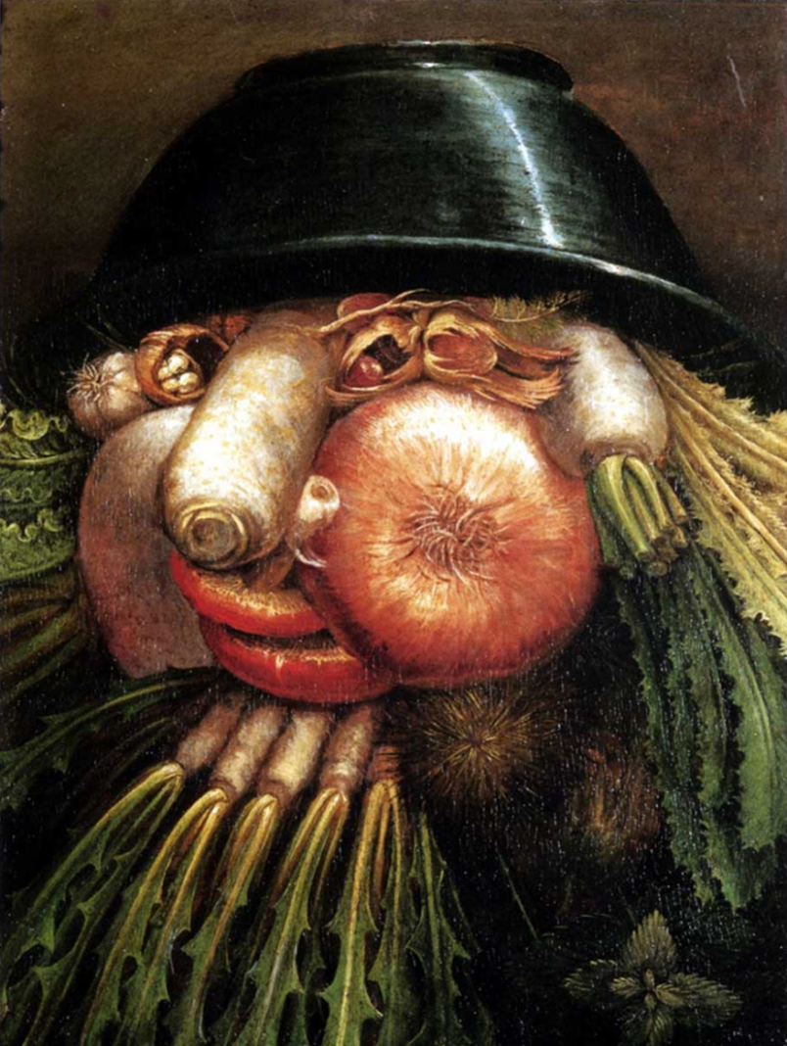
The Brain is a Generative Model for its Sensorium
The Gardener Giuseppe Arcimboldo ~1590
The brain is a hierarchy of (autonomously operating) generative models, each nested within the next and predicting the activity of the layer below. The lowest layer predicts the sensorium.
All processing is (variational) Bayesian inference in the generative models.

Slide 6

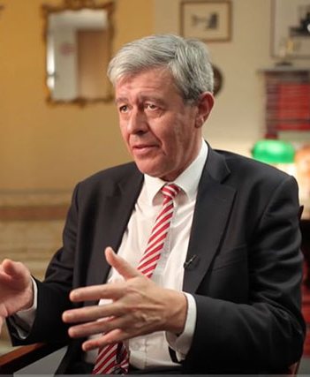
The Mechanism of Control
Richard Bellman (~1960)
Karl Friston (~2005)
“Control minimizes a cost function of state of the world”
“(In biotic systems,) control is a side-effect of optimizing beliefs about the state of the world”

Slide 7

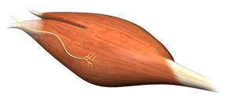


Active Inference
action
planning
Physics
perception
observation

Slide 8

The Engineering Challenge
action
planning
Simulated
Physics
Physics
perception
observation

Slide 9


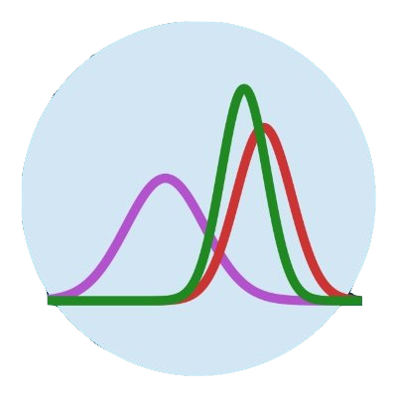






Software for Automated Free Energy Minimization?
Desiderata
Existing PPLs
Pyro / NumPyro
Model scope
Low-power
Turing
RxInfer
User-friendly
Adaptivity
PyMC3
ForneyLab
Performance
Real-time
Notes:
So we in BIASlab do want to build such a software with such nice characteristics. It is always about tradeoffs, we do something better in one particular domain, and other libraries might be better in a different domain. But we are really focusing on this particular properties.

Slide 10
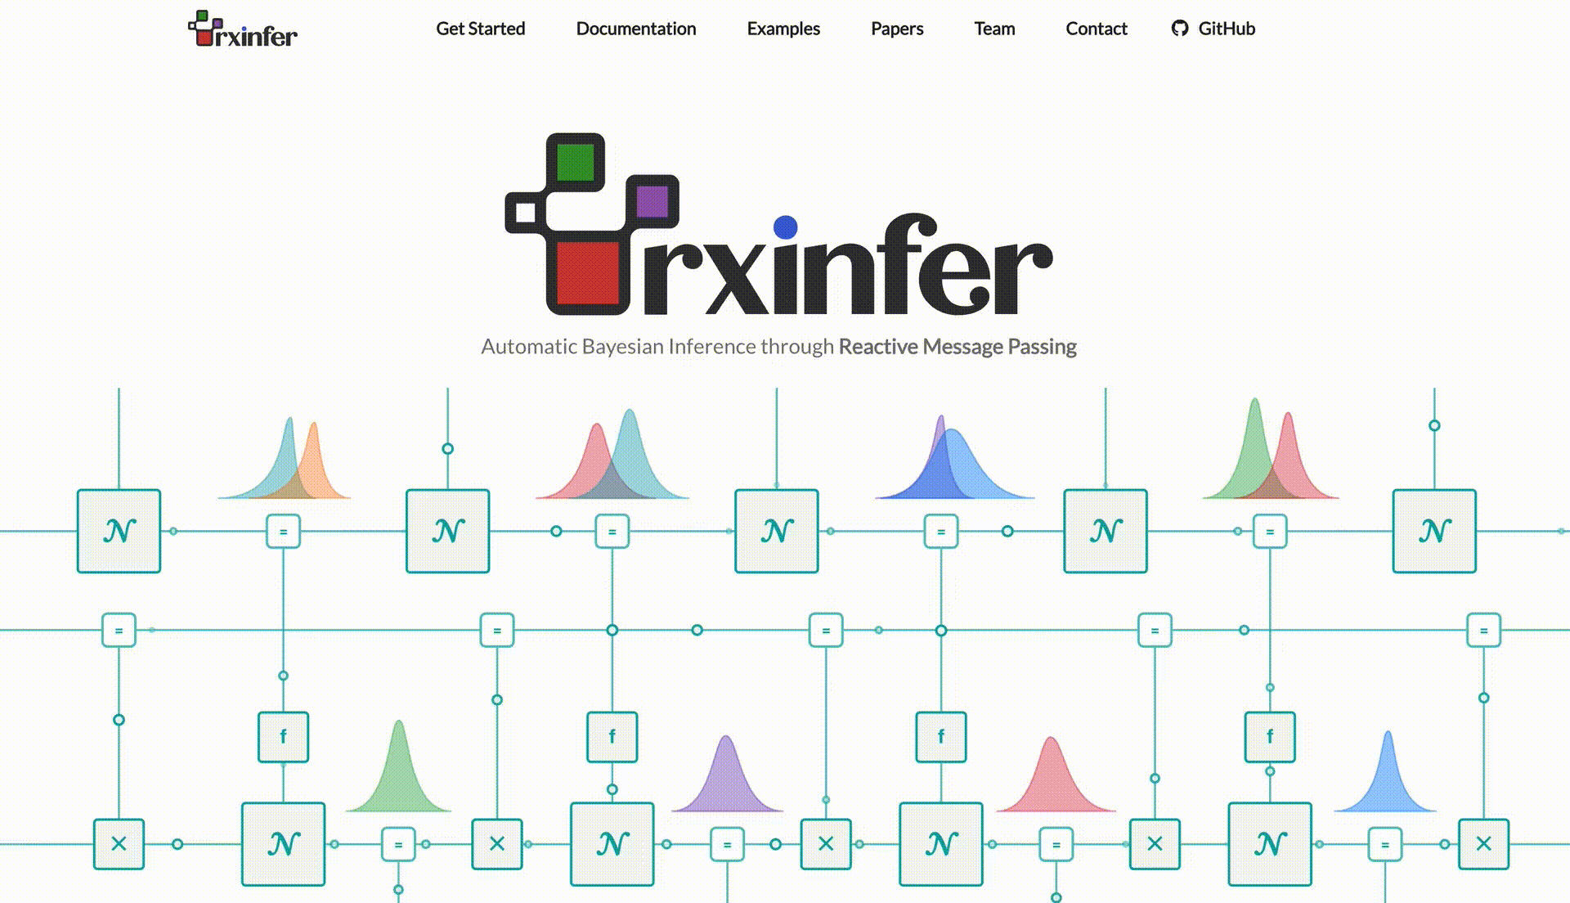

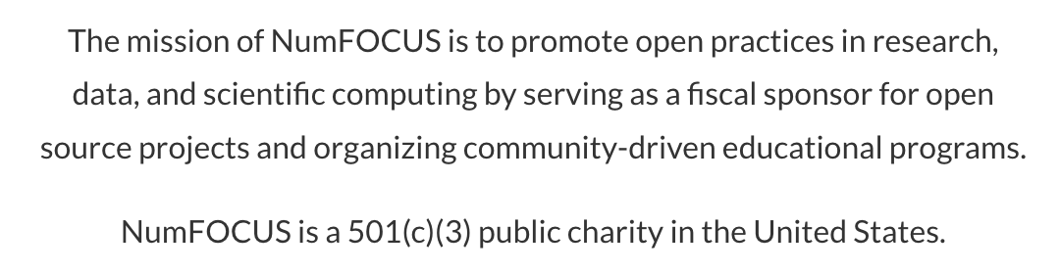
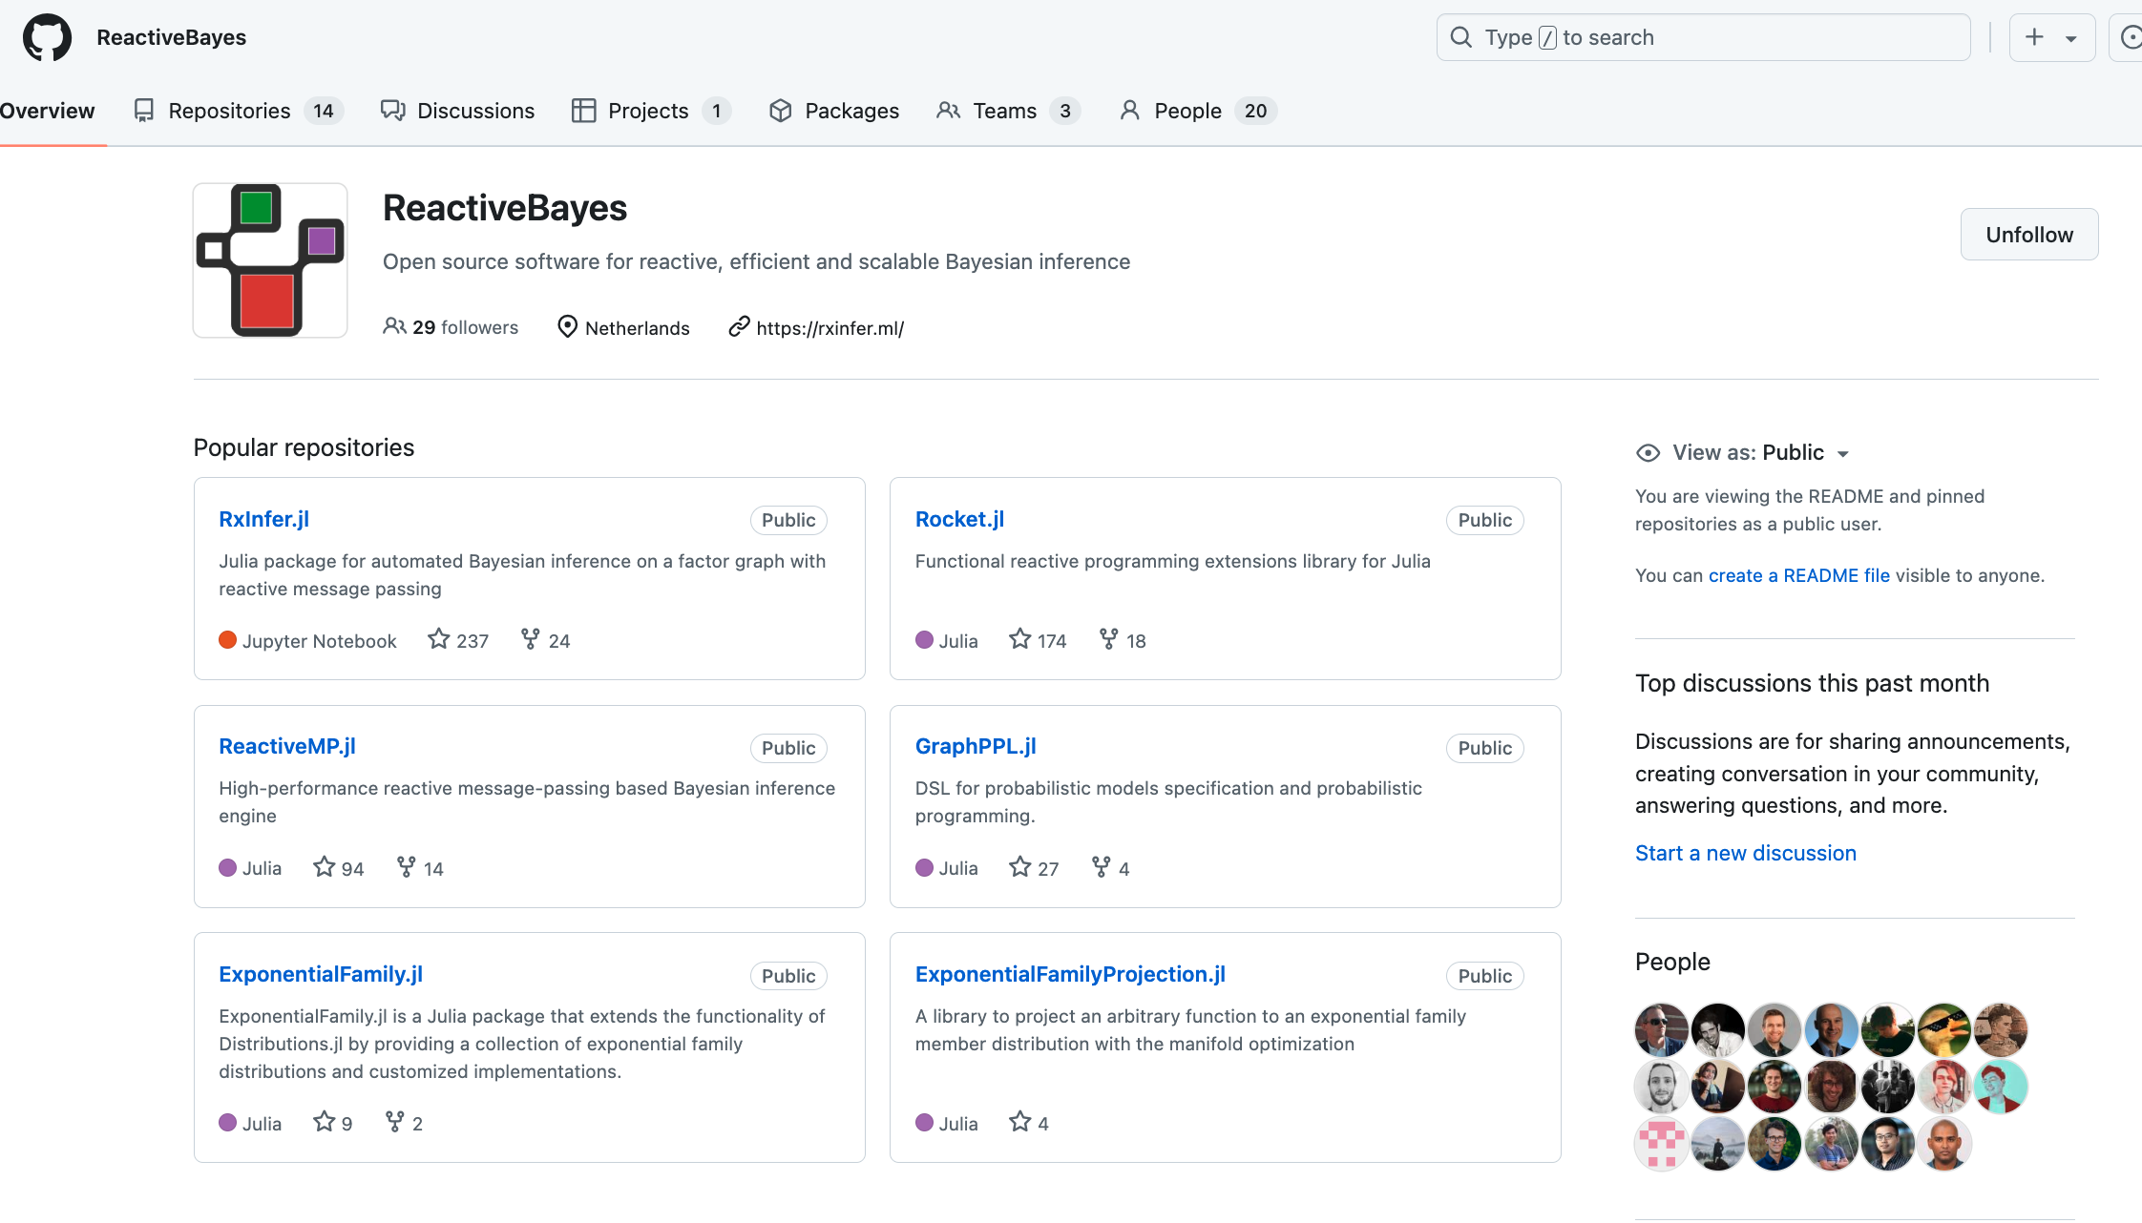
RxInfer: A Software Toolbox for Scalable, Real-time, Automated Free Energy Minimization
rxinfer.com
Notes:
Parallel Distributed Processing

Slide 11
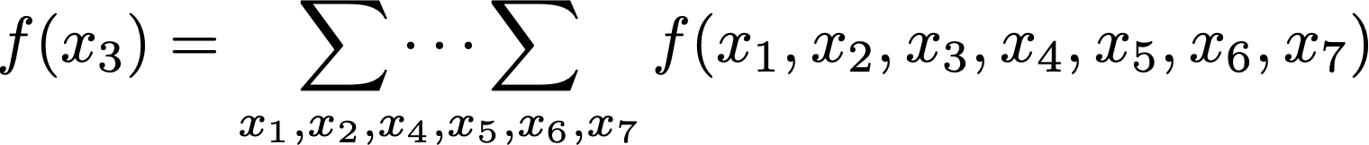
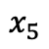
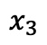
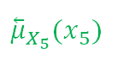
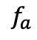
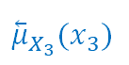
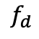
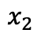
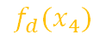
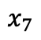

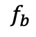
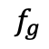
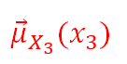
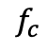
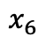
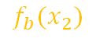
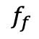
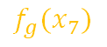




Message Passing for Scalability
$$f\left(x_{1},x_{2},x_{3},x_{4},x_{5},x_{6},x_{7}\right)=f_{a}\left(x_{1}\right)∙f_{b}(x_{2})∙f_{c}(x_{1},x_{2},x_{3})∙f_{d}(x_{4})∙f_{e}(x_{3},x_{4},x_{5})∙f_{f}(x_{5},x_{6},x_{7})∙f_{g}(x_{7})$$
$$f_{b}$$
$$f_{d}$$
$$x_{2}$$
$$f_{b}(x_{2})$$
$$x_{4}$$
$$f_{d}(x_{4})$$
$$f_{a}(x_{1})$$
$$x_{3}$$
$${\overset{⃖}{μ}}_{X_{3}}(x_{3})$$
$${\overset{⃖}{μ}}_{X_{5}}(x_{5})$$
$$1$$
$$f_{a}$$
$$f_{c}$$
$$f_{e}$$
$$f_{f}$$
$$x_{1}$$
$$x_{5}$$
$$x_{6}$$
$${\vec{μ}}_{X_{3}}(x_{3})$$
$$x_{7}$$
$$f_{g}(x_{7})$$
$$f_{g}$$
If each variable has 10 possible values, then inference complexity drops from ${O(10}^{6})$ to ${O(10}^{2})$ # additions.

Slide 12





RxInfer Works ☺
Notes:
And we did it easy, but not as easy!

Slide 13




Multi-agent Planning
generative
model
goal
priors
15 lines of code!
~
Notes:
Strong effort, limited effort

Slide 14


Dynamic Obstacle Avoidance in Drone Swarms
generative
model
goal
priors
10 lines of code!
~
Notes:
Strong effort, limited effort

Slide 15























EFE-based Planning as Inference: The Expected Free Energy Theorem
$$\tilde{p}(u_{t+1})$$
$$\tilde{p}(u_{T})$$
$$x_{τ}^{+}$$
$$x_{τ}^{+}$$
$$u_{1}$$
$$u_{t}$$
$$u_{t+1}$$
$$u_{T}$$
$$x_{T}$$
$$x_{0}$$
=
$$x_{t−1}$$
$$x_{t}$$
=
$$x_{T−1}$$
=
=
$$\hat{p}\left(x_{0}\right|x_{τ}^{+})$$
$$p\left(x_{t+1}\right|x_{t},u_{t+1})$$
$$\hat{p}\left(x_{T}\right|x_{τ}^{+})$$
$$p\left(y_{1}\right|x_{1})$$
$$y_{1}$$
$$y_{t}$$
$$\tilde{p}(x_{t+1})$$
$$\tilde{p}(x_{T})$$
If we choose
$$t_{}$$
$\tilde{p}\left(x\right)=\exp\left( −H\left[q\left(y | x\right)\right] \right)$ and $\tilde{p}\left(u\right)=\exp\left( H\left[q\left(x | u\right)\right] \right)$
then …
In other words, selecting policies by minimizing Expected Free Energy (EFE) emerges naturally from standard variational free energy minimization when applied to a rollout of the generative model into the future, where the inference process is guided by both target priors and epistemic priors.

Slide 16




Solving Mini-grid Door-Key Problem
~10 lines of code!
setup
epistemic
priors
generative
model
goal
prior
w. Wouter
Nuijten
Notes:
Strong effort, limited effort

Slide 17
Why Active Inference Agents (rather than RL, MPC, …)?
People say (I’ve heard …)
Principled. Derived from foundational physics / information theory.
EFE-based planning balances goal-driven vs information-seeking behavior, without need for tuning parameters.
AIF requires no reward function.
AIF is explainable and trustworthy, due to separation of assumptions from a Bayes-optimal reasoning process. (application to medical AI!!)
Yes, plus …
Robustness by RMP realization! RMP-AIF is a reactive, fully-distributed (in both time and space) process, which is robust to fluctuating computational resources (both in energy, data, and time).
Keeps working on power dips, missing and poor observations, hard interrupt at decision time, …
Planning as (interruptible!) Inference
Easy to code! <1 page for generative model.
Potential for Scaling: Real-time inference in large models with ultra-low computational load.

Slide 18
Conclusions / Recapitulation
The Free Energy Principle offers a principled foundation for adaptive, self-organizing agents.
Active Inference (AIF) unifies perception, learning, and action as variational Bayesian inference.
Personalized control emerges naturally in AIF agents through Expected Free Energy minimization.
Local message passing on a factor graph enables efficient, real-time inference on low-power devices.
AIF provides a promising alternative to RL/MPC in dynamic, uncertain environments.
Tooling maturity remains limited; advancing practical AIF frameworks is a key future objective.
RxInfer aims to provide a path toward deployable, embedded Bayesian intelligence.

Slide 19
Thank you

